Slide 1
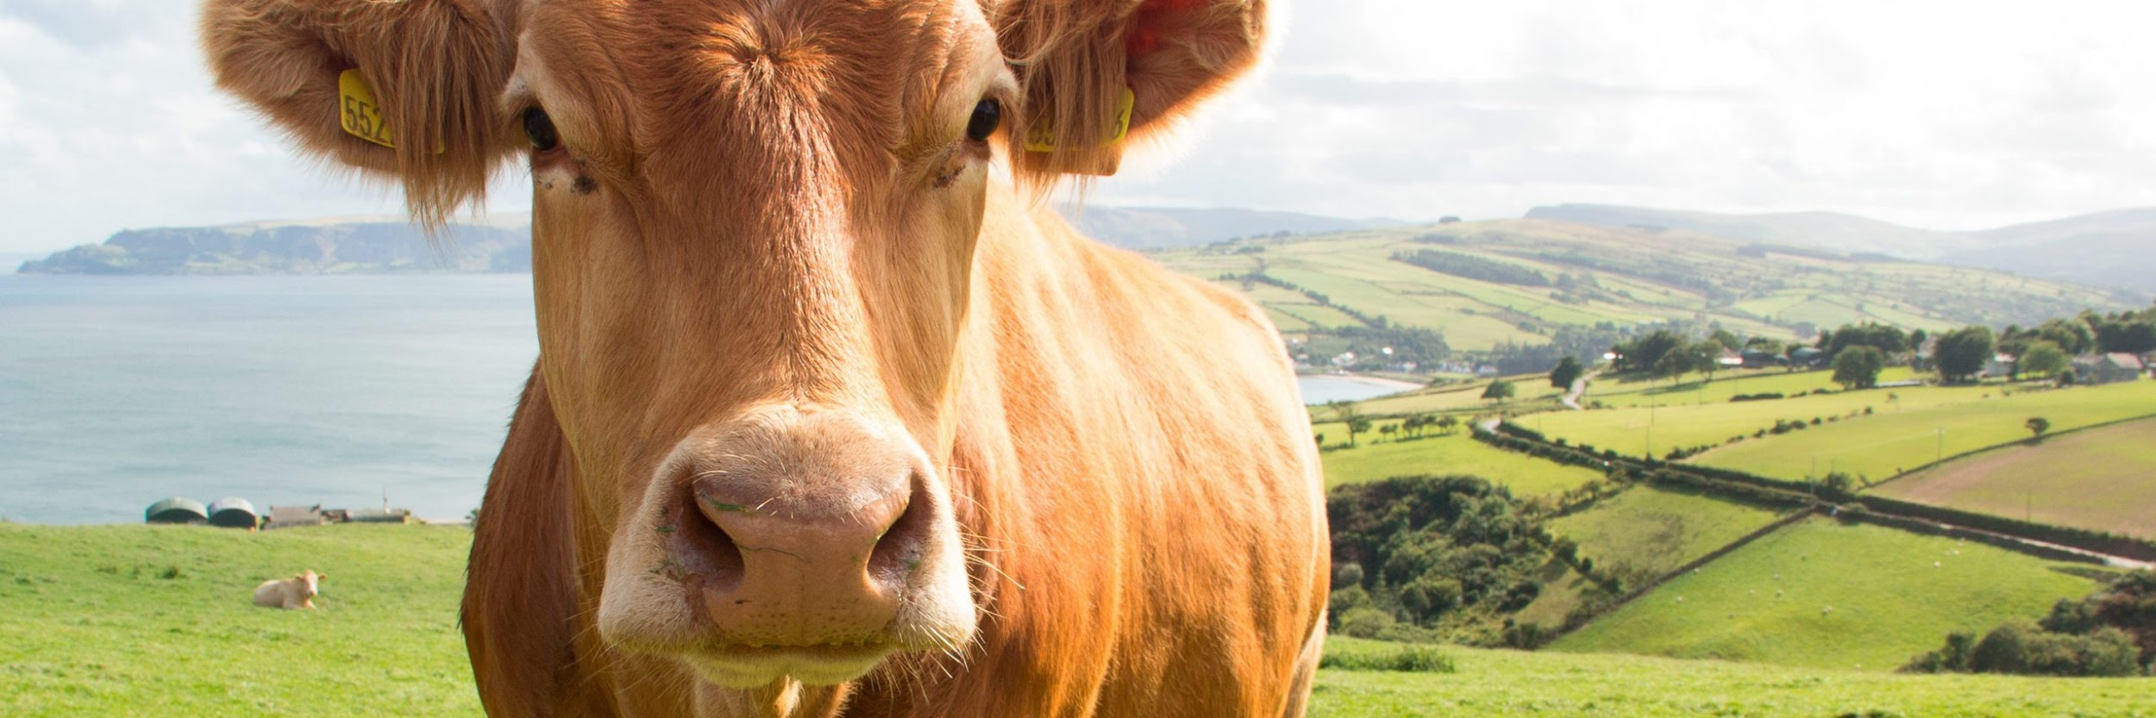

Compression algorithms to optimize battery consumption in precision livestock farming

Slide 2

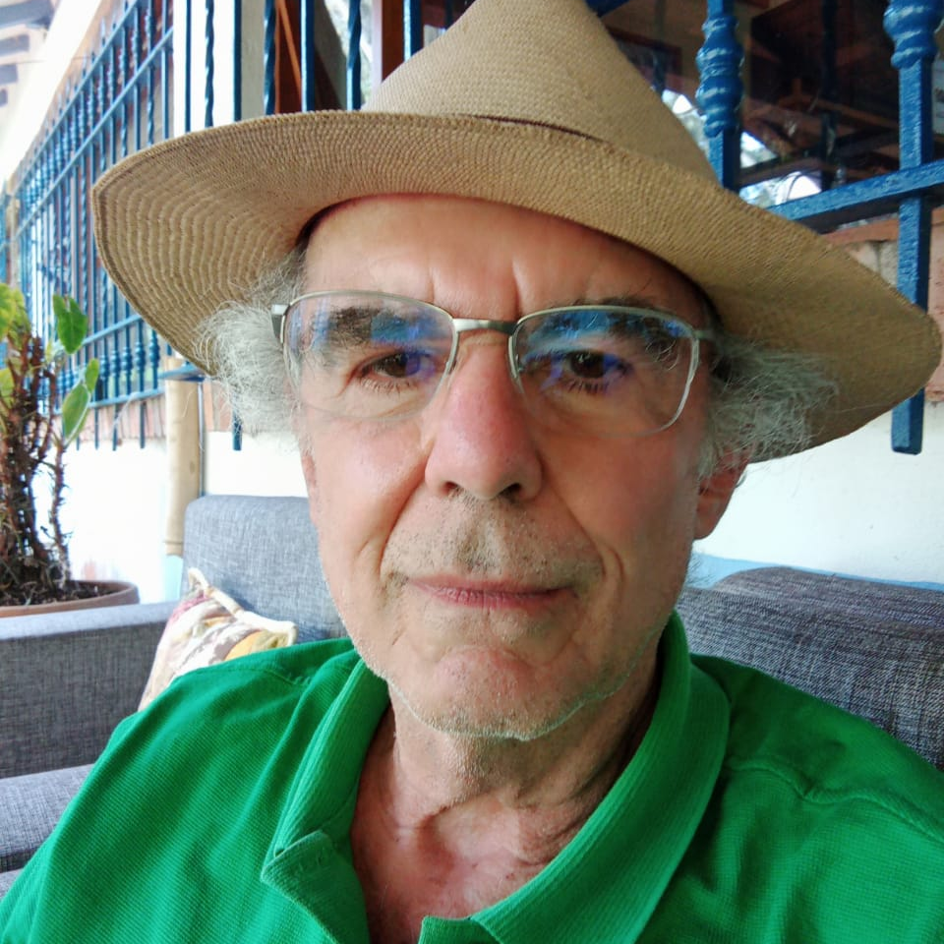
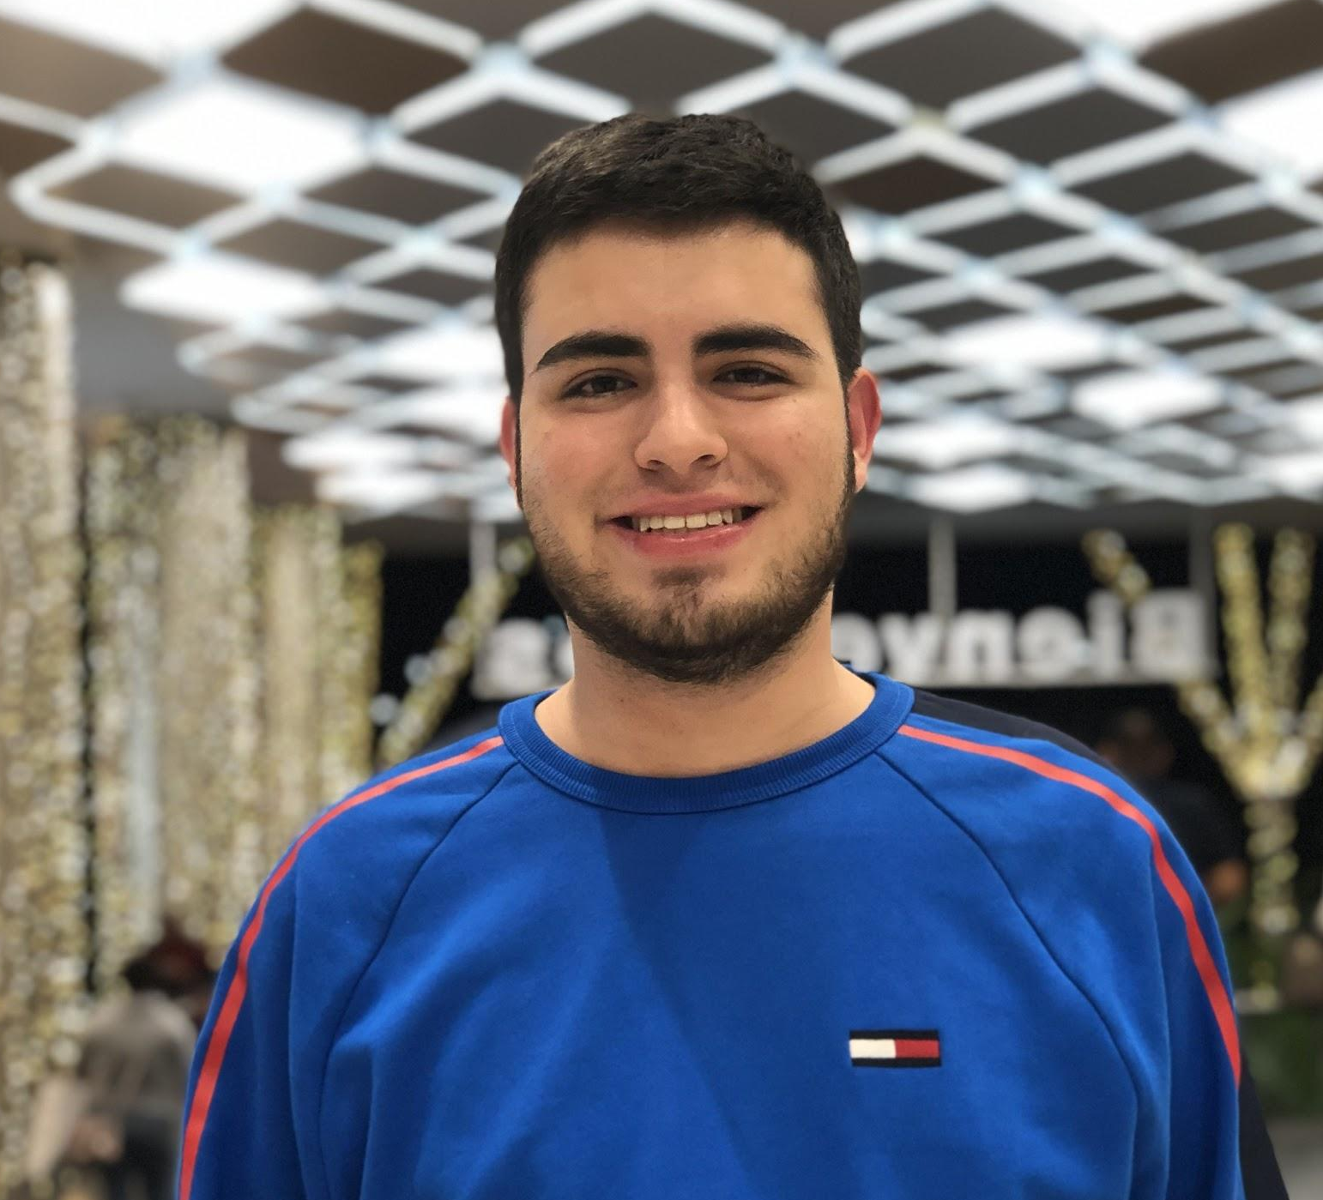
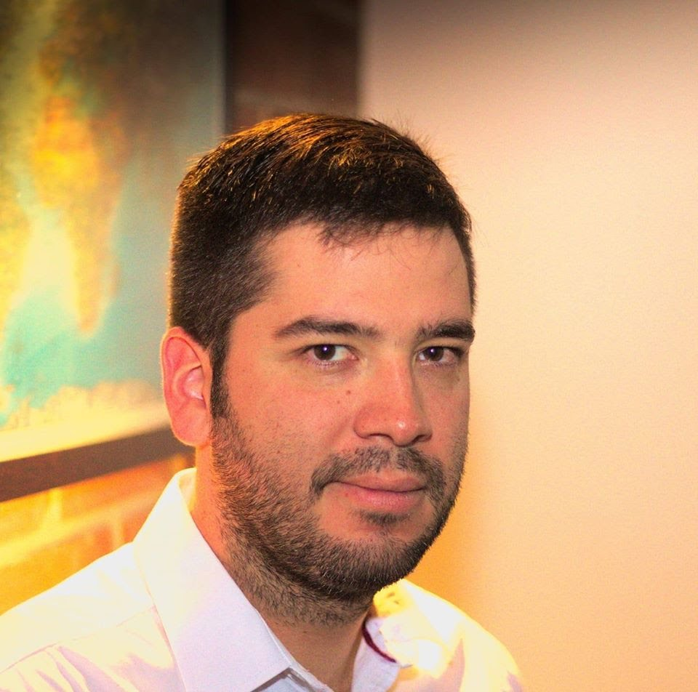

Team Presentation
Hernan
Moreno
Mariana
Yepes
Simón Marín
Mauricio
Toro
https://github.com/homorenom/ST0245-003/tree/master/proyecto/informe/entrega1

Slide 3
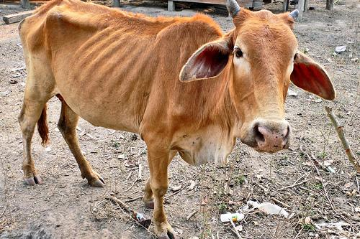
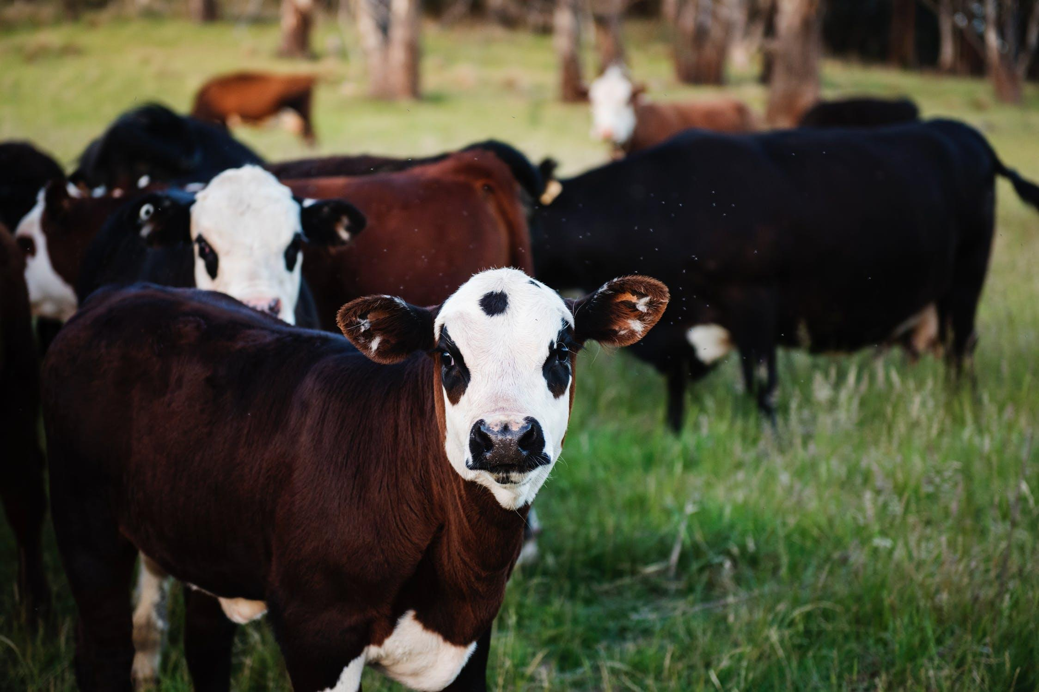
Training Process
Convolutional Neural Network
Sick-Cattle Images
Classification Algorithm
Classification Model
Healthy-Cattle Images

Slide 4
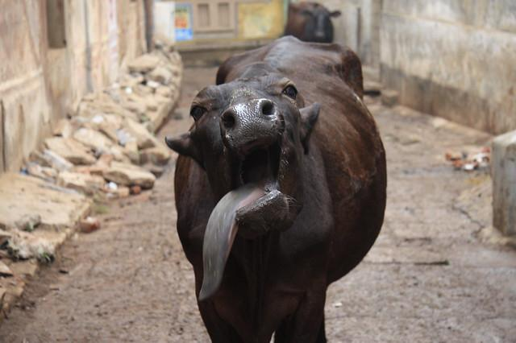
Testing Process
???
Is sick
Cattle Image
??? Compression Algorithm
Classification Model
Output

Slide 5
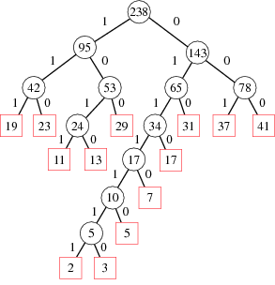
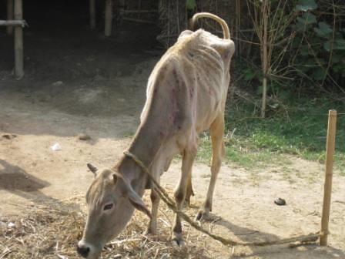
Compression Algorithm Design
Image compression algorithm for animal-health automatic classification (In this semester, one could be LZS, Huffman, LZ77, LZ78… please choose).

Slide 6
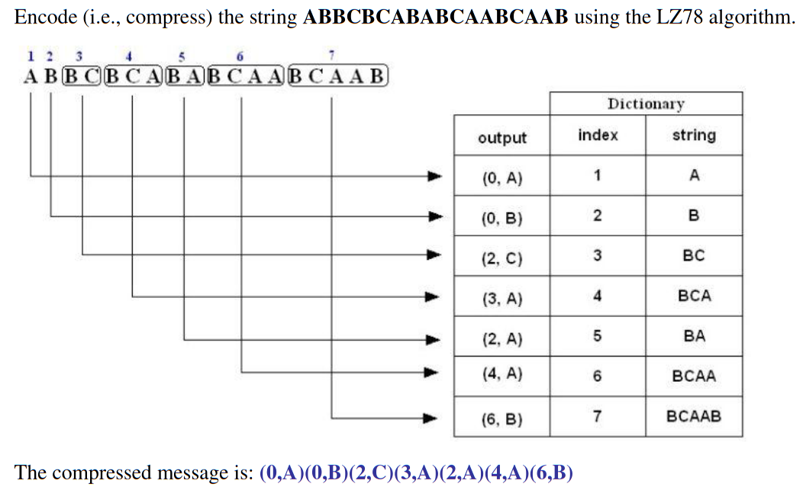
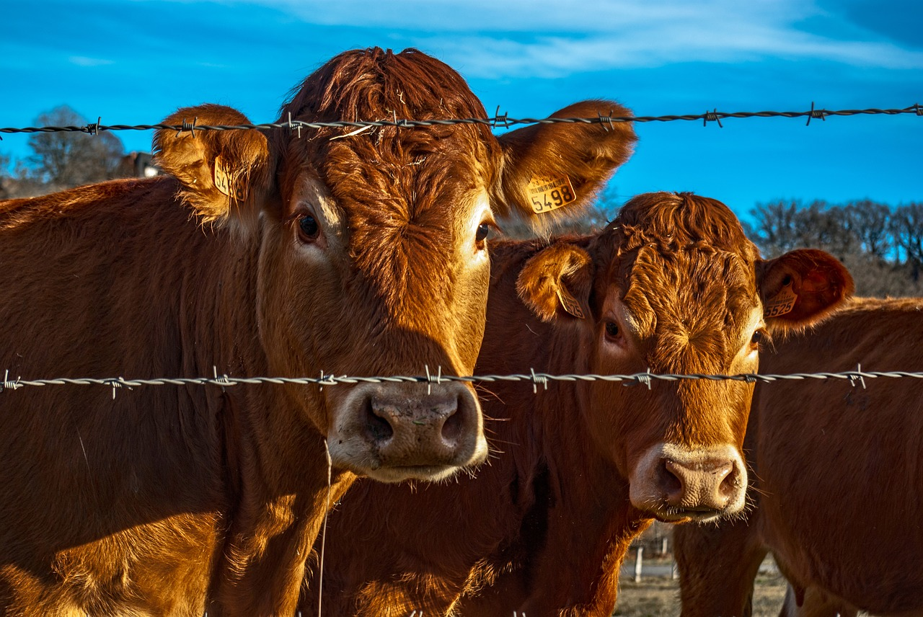
Compression Algorithm Design

Slide 7
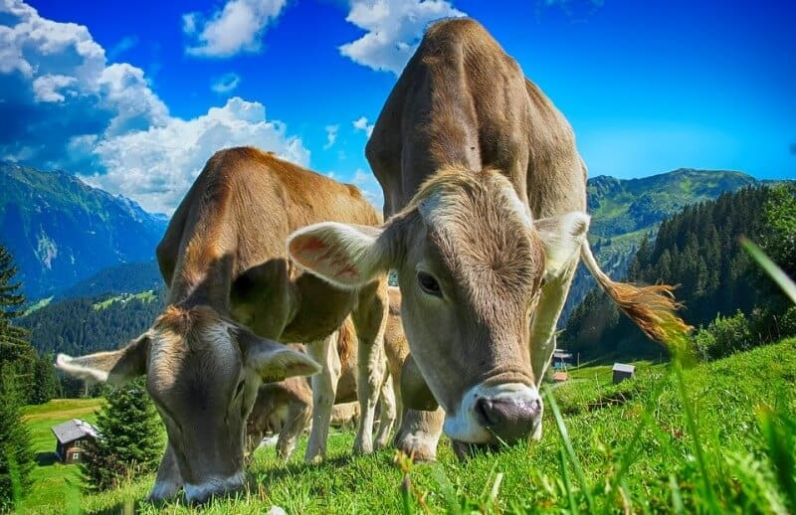
Compression Algorithm Complexity
 | Time Complexity | Memory Complexity
Image compression | O(N²*M*2^{M}) | O(N*M*2^{M})
Image decompression | O(N*M) | O(1)
Time and memory complexity of the (In this semester, one could be LZS, LZ77, LZ78, Huffman… please choose) algorithm. Please explain what do N and M mean in this problem. PLEASE DO IT!

Slide 8
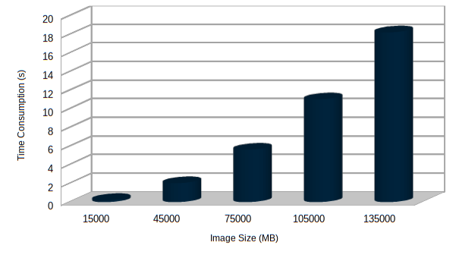
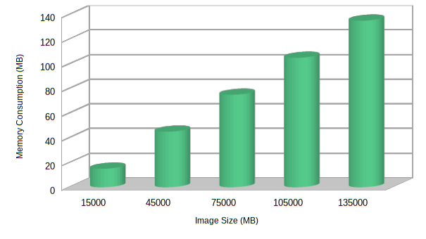


Time and Memory Consumption
Time Consumption
Memory Consumption

Slide 9
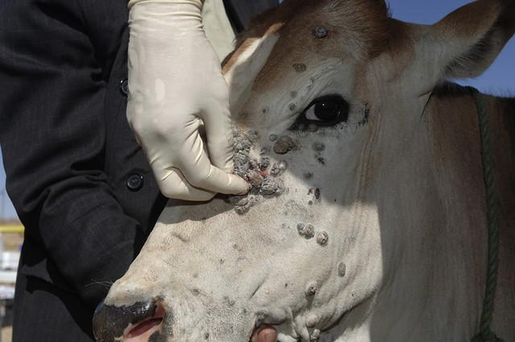
Average Compression Ratio
 | Compression Ratio
Healthy Cattle | 100 : 1
Sick Cattle | 98 : 1
Average compression ratio for Healthy Cattle and Sick Cattle.

Slide 10
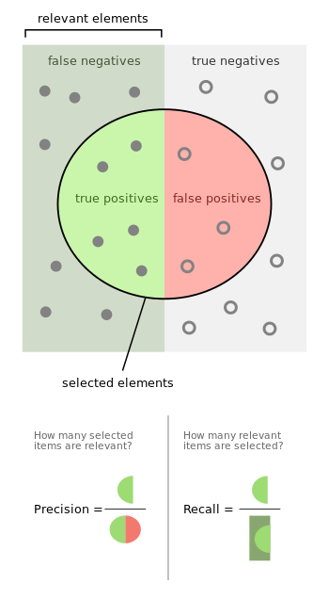
Classification Evaluation Metrics

Slide 11
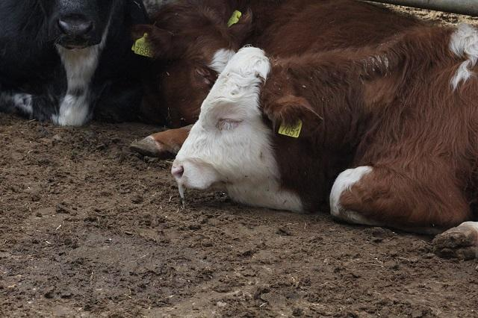
Classification Evaluation Metrics
 | Testing data set (original images) | Testing data set (compressed images)
Accuracy | 0.3 | 0.2
Precision | 0.25 | 0.21
Recall | 0.12 | 0.11
Evaluation metrics using a testing dataset of ?? healthy cattle and ?? sick cattle images. Compressed images were obtained with ??? algorithm (Please, complete with your algorithm)

Slide 12
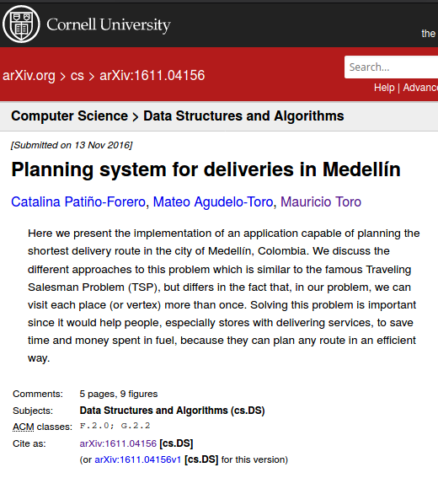
Report Accepted on arXiv
C. Patiño-Forero, M. Agudelo-Toro, and M. Toro. Planning system for deliveries in Medellín. ArXiv e-prints, Nov. 2016. Available at: https://arxiv.org/abs/1611.04156

Slide 13
THANK YOU!.
Supported by
The first two authors are supported by a Sapiencia grant financed by Medellín municipality. All the authors would like to thank the "Vicerrectoría de Descubrimiento y Creación", of Universidad EAFIT, for their support on this research

